Slide 1

Getting Started with Skype
Presented by: ____________________

Slide 2
Purpose and Objectives
Today’s training will focus on getting started with Skype. By the end of the session you should be able to:
Describe what Skype is
List and describe some of the important features of Skype
Be able to install Skype, create an account, add contacts, and start a conversation.

Slide 3



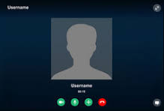
What is Skype?
Software program that works on multiple devices
Communicate through text, voice or video phone calls

Slide 4
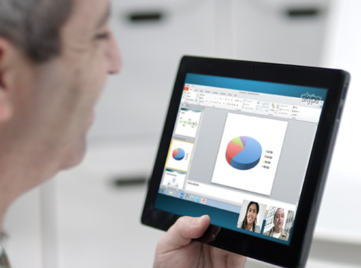
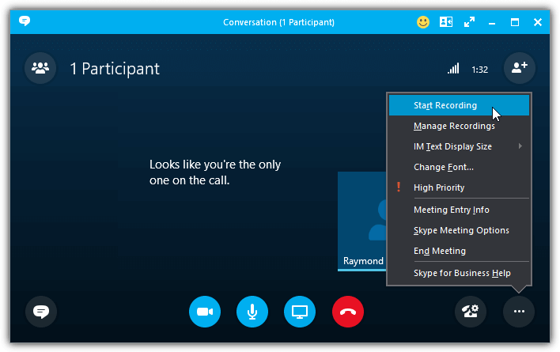

Important Features of Skype
Screen Sharing
Call Recording
File Sharing

Slide 5

How to Get Started Using Skype

Slide 6

Thank You for Attending
Any Questions?

